Slide 1
Getting Started
with Android application development
Muneerah AlDhafian
Scientific material is prepared by Elm Company & Devslopes by Mark Price and me ‘Muneerah AlDhafian’.

Slide 2
Day 1 Android Fundamentals
Introduction to Android and Android development
Building your first application
Android application building blocks, Activity and it's lifecycle
Percentage Calculator Application.
Assignment-1 Multiplication App.

Slide 3
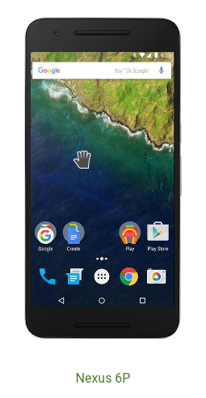
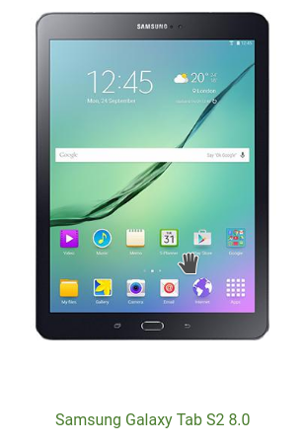
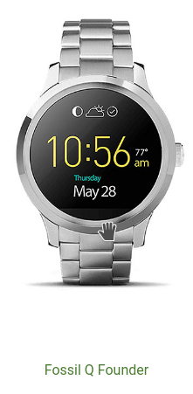
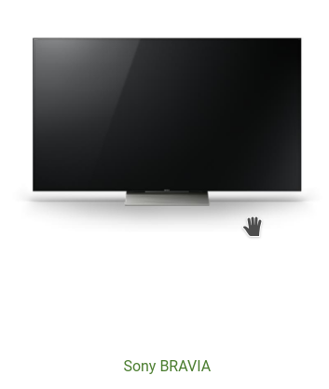

Introduction
What’s Android
Android Platform
Android versions
Apps development
Development environment

Slide 4
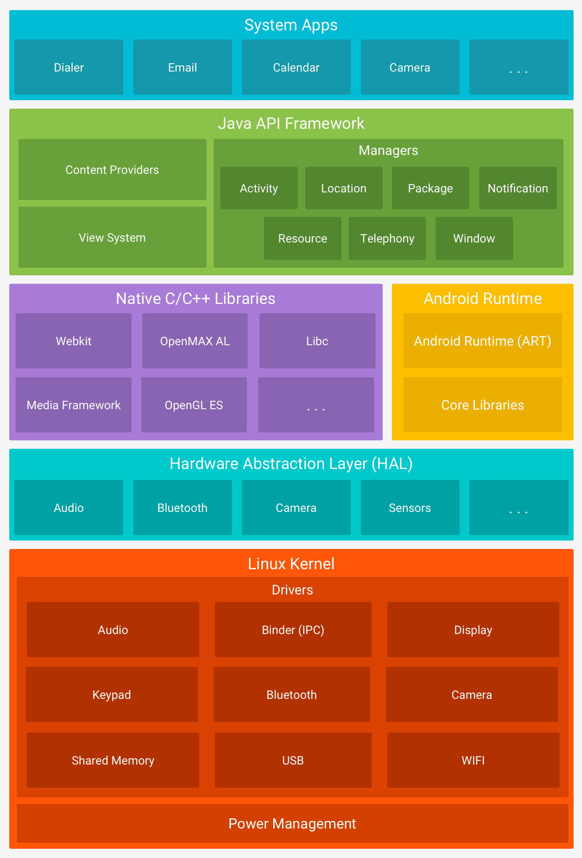
Introduction
What’s Android
Android Platform
Android versions
Apps development
Development environment

Slide 5
Introduction
Code name | Version Number | API Level
Cupcake | 1.5 | 3
Donut | 1.6 | 4
Eclair | 2.0 – 2.1 | 5–7
Froyo | 2.2 – 2.2.3 | 8
Gingerbread | 2.3 – 2.3.7 | 9–10
Honeycomb | 3.0 – 3.2.6 | 11–13
Ice Cream Sandwich | 4.0 – 4.0.4 | 14–15
Jelly Bean | 4.1 – 4.3.1 | 16–18
KitKat | 4.4 – 4.4.4 | 19–20
Lollipop | 5.0 – 5.1.1 | 21–22
Marshmallow | 6.0 – 6.0.1 | 23
Nougat | 7.0 | 24
What’s Android
Android Platform
Android versions
Apps development
Development environment

Slide 6
Introduction
Java programming language
Android framework (API)
C/C++
Kotlin ^{“new”}
What’s Android
Android Platform
Android versions
Apps development
Development environment

Slide 7
Introduction
Android Studio 2.2
Java openJDK 8
Android SDK 24+
What’s Android
Android Platform
Android versions
Apps development
Dev. environment

Slide 8
Day 1 Android Fundamentals
Introduction to Android and Android development
Building your first application
Android application building blocks, Activity and it's lifecycle
Percentage Application.
Assignment-1 Multiplication App.

Slide 9
Before building our first app, let’s have some
Android 101

Slide 10
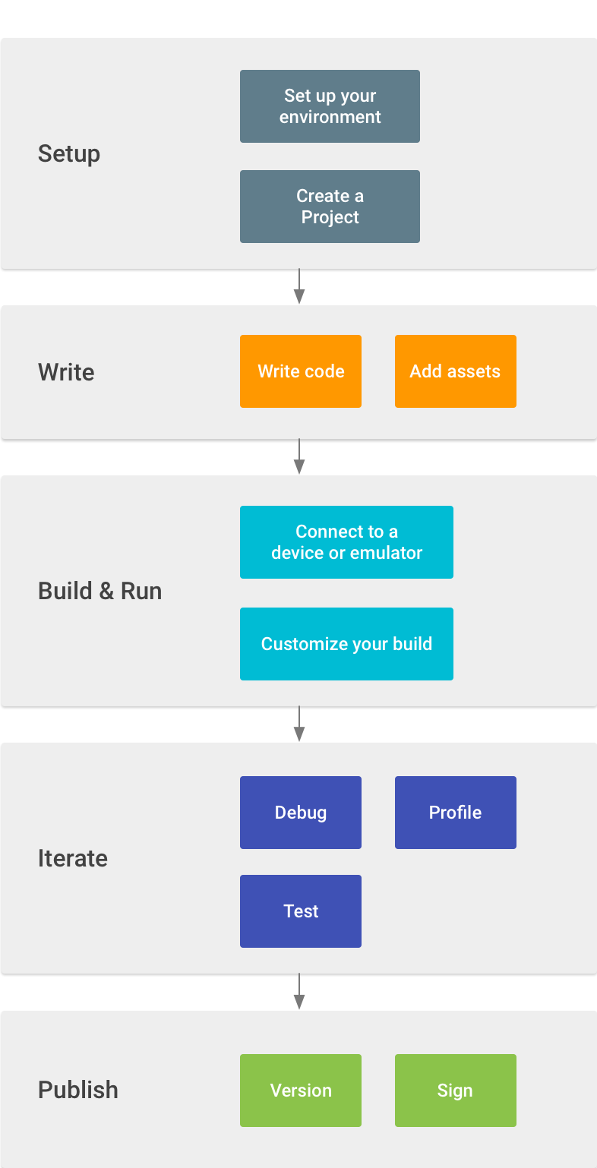
Developer workflow

Slide 11
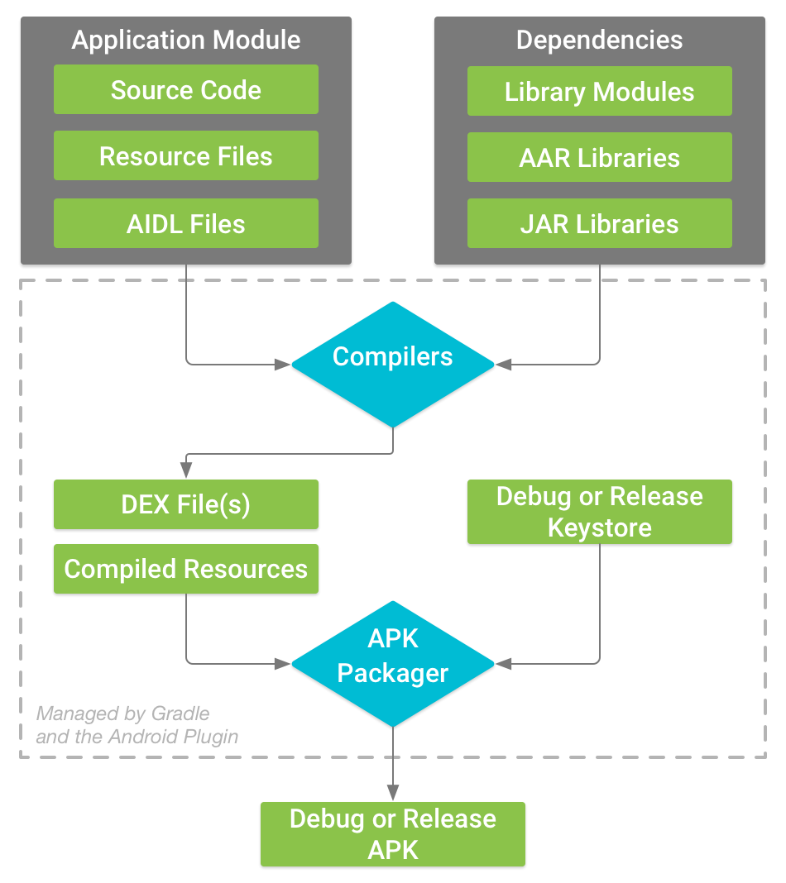
Build process & Android Package APK

Slide 12
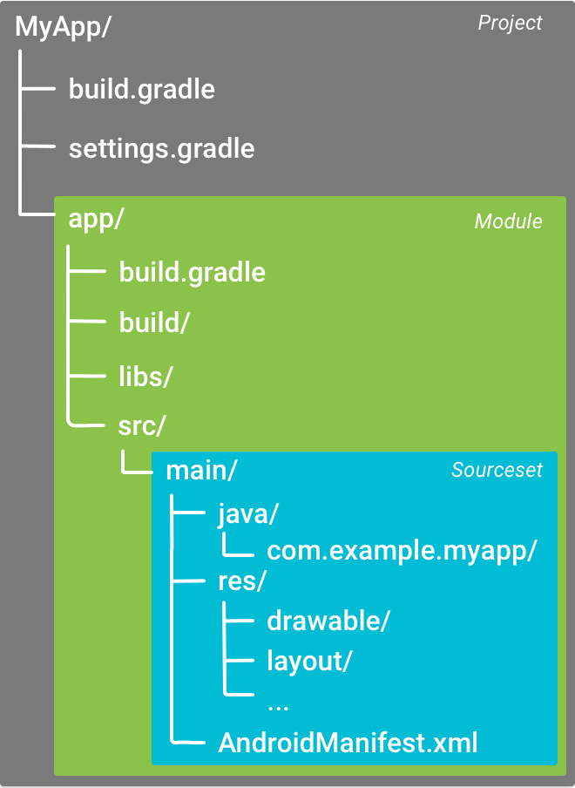
Project structure

Slide 13
Android Manifest
Required file for each application
Contains application components
Declare application permissions
API level: Compile, Target and Minimum

Slide 14
Gradle
Advanced build system
Configurable
Android Gradle Plugin (Build type, flavors, build variants, ..etc)

Slide 15
Resource files
Layouts (UI files)
Images and drawables
Values: strings, dimens, colors, arrays and styles
Localizations
Screen sizes

Slide 16
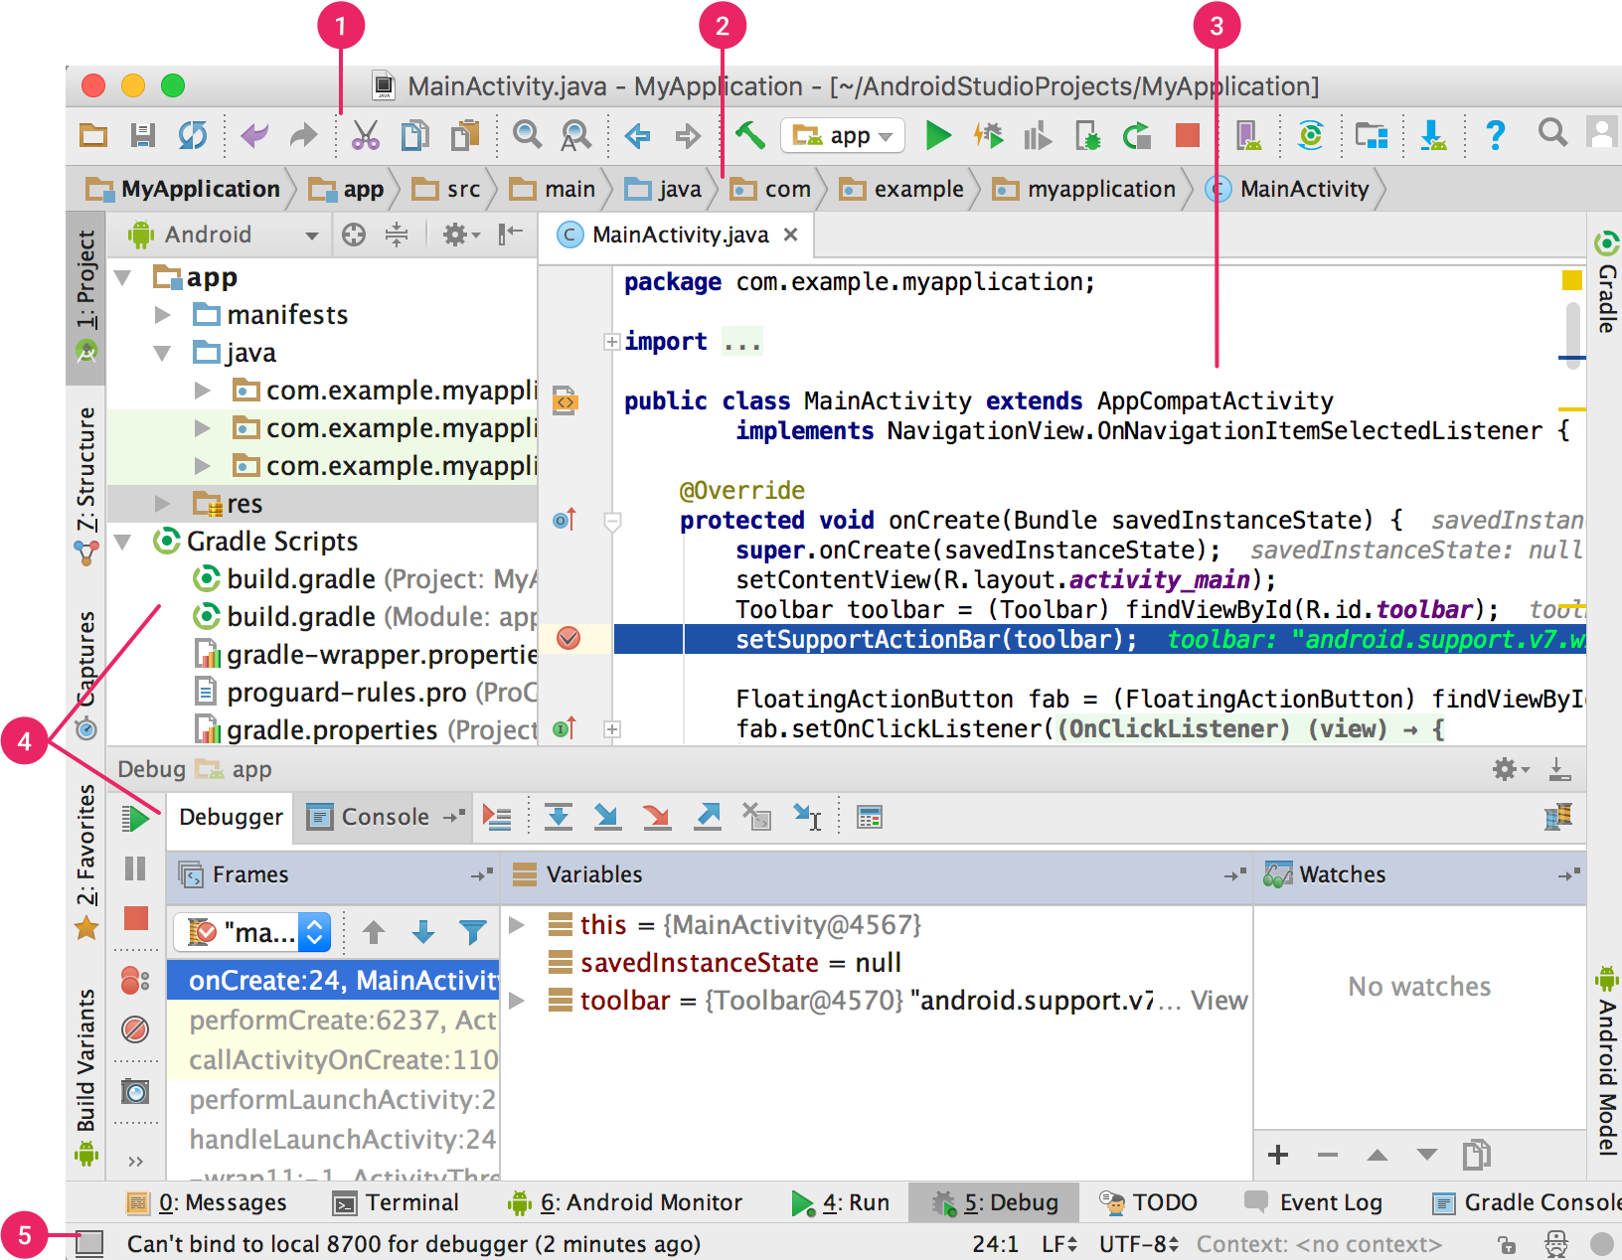
Android Studio 2.2+
Toolbar
Navigation bar
Editor Window
Tool windows
Status bar

Slide 17
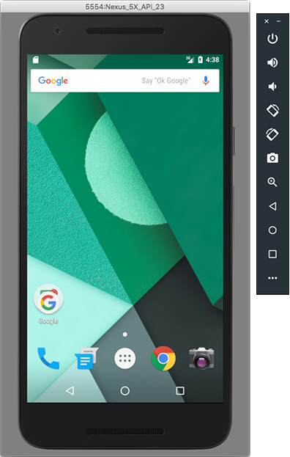
Android Emulator

Slide 18
Demo #1
Hello, World!
Create new project
IDE & files structure
Android Manifest
Gradle
Resources
Run the app on Emulator and real devices

Slide 19
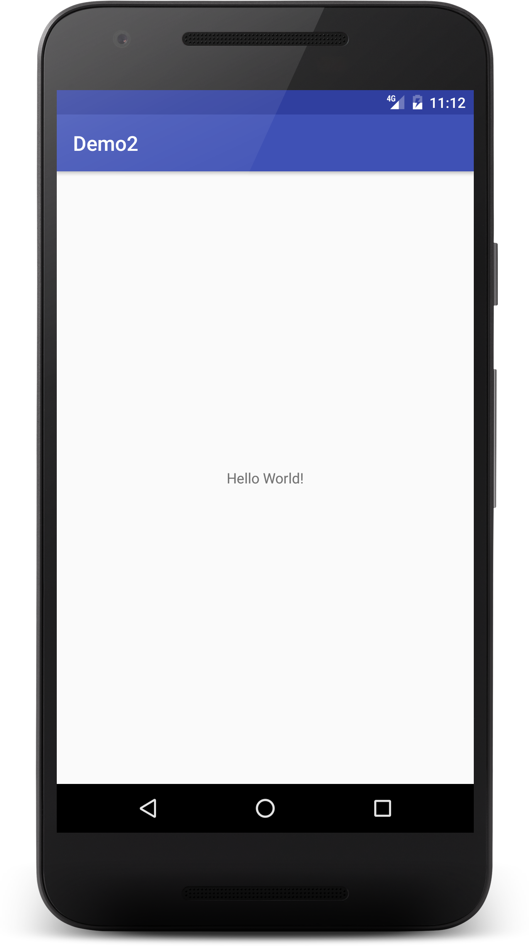
Exercise #1
Create and Run your first application

Slide 20
Day 1 Android Fundamentals
Introduction to Android and Android development
Building your first application
Android application building blocks, Activity and it's lifecycle
Percentage Application.
Assignment-1 Multiplication App.

Slide 21
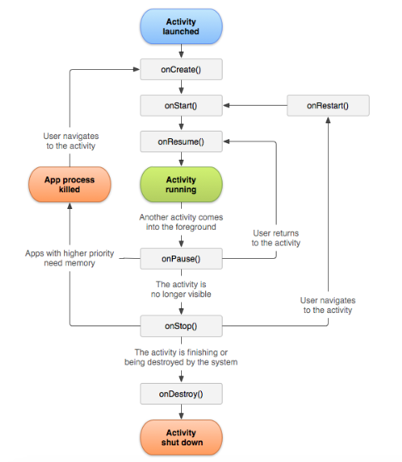
The Activity Lifecycle

Slide 22
Activity Lifecycle Demo
Will add a dialog message & counter to each callback methods used during the activity lifecycle.

Slide 23
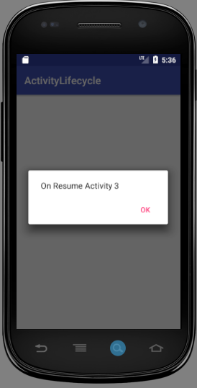
Exercise #1
Create and Run your first application

Slide 24
Day 1 Android Fundamentals
Introduction to Android and Android development
Building your first application
Android application building blocks, Activity and it's lifecycle
Percentage Application.
Assignment-1 Multiplication App.

Slide 25
Exercise #1
Create and Run your first application

Slide 26
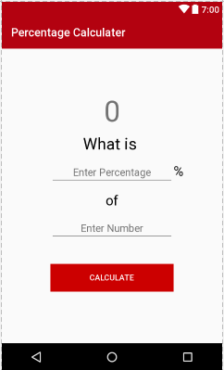
Demo #2
Create and Run your first application

